Slide 1

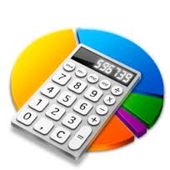

NUMERICAL COMPUTATION & EXPRESSION (part 1)
Topic 3

Slide 2

Objectives
To learn about the declaration and use of variables
To learn about primitive data
To learn about character strings
To learn about expressions and order of precedence

Slide 3
Outline
Variables
Primitive Data Types & Assignments
Character Strings
Expressions & order of precedence

Slide 4

Introduction
In a JAVA program, we need to give names to its components:
class
variable
constant
method
Identifiers
Technical term used for a program component’s name

Slide 5
Identifiers
Rules for identifiers in Java:
Can be made up of letters, digits, $ sign and the underscore (_) character
Cannot start with a digit
Cannot use other symbols such as ? or %
Spaces are not permitted inside identifiers
Cannot use reserved words
They are case sensitive
They can be of any length

Slide 6
Java Language Reserved words
abstract default if private throw
boolean do implements protected throws
break double import public transient
byte else instanceof return try
case extends int short void
catch final interface static volatile
char finally long super while
class float native switch
const for new synchronized
continue goto package this
Cannot be used as identifiers

Slide 7
Variables
A variable is a name for a location in memory that holds a value.
A variable declaration specifies the variable's name and the type of information that it will hold.
variable name
data type
int total;
int count, temp, result;
double totalPrice;
Multiple variables can be created in one declaration

Slide 8
Analogy: to calculate the area of 3 different rectangles
4cm
8cm
5cm
2cm
2cm
3cm
Rect 1
Rect 2
Rect 3
Area = 2 * 4
_________
_________
Area = 2 * 8
__________
__________
Area = 3 * 5
_________
_________
3 different Java programs

Slide 9
So What to do?
VARIABLES
Find general solution:
rectArea = Width * Length
rect_1 = 2 * 4
rect_2 = 2 * 8
rect_3 = 3 * 5
rect_4 = 9 * 7
_______
_______
_______
_______
1 Java program for 4 rectangles calculation

Slide 10
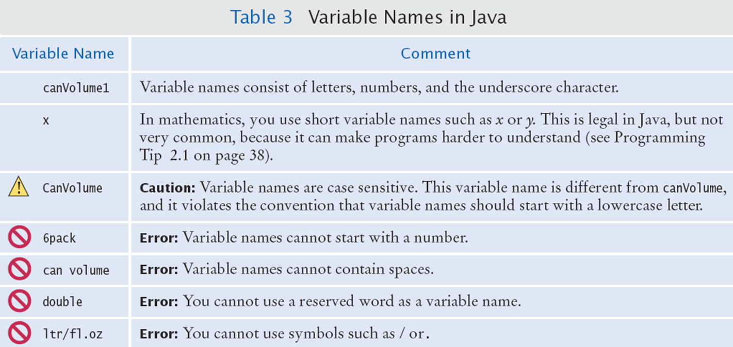
Legal and illegal variable names

Slide 11
Constants
A constant is an identifier that is similar to a variable except that it holds the same value during its entire existence.
As the name implies, it is constant, not variable.
The compiler will issue an error if you try to change the value of a constant.
In Java, we use the final modifier to declare a constant
final int MIN_HEIGHT = 69;
final double PI = 3.142;

Slide 12
Constants
Constants are useful for three important reasons:
They give meaning to unclear literal values
- maximum number of student in a class is 40 (fixed). We
give a name for that value:
final int MAX_NO_OF_STUDENT = 40;
They facilitate program maintenance
If a constant is used in multiple places, its value need only be set in one place
They formally establish that a value should not change, avoiding inadvertent errors by other programmers

Slide 13
Best Practice for Naming Identifiers
By convention:
variable names start with a lowercase letter
totalPrice, circleArea, totalCgpa.
class names start with an uppercase letter
CalculatePrice, CountCircleArea, DetermineCgpa
constant names are in uppercase letters, two words are separated by underscore ( _ )
PI, MAX_HEIGHT

Slide 14
Outline
Variables
Primitive Data Types & Assignments
Character Strings
Expressions & order of precedence

Slide 15
Primitive Data Types
There are eight primitive data types in Java
Four of them represent integers:
byte, short, int, long
Two of them represent floating point numbers:
float, double
One of them represents characters:
char
And one of them represents boolean values:
boolean

Slide 16
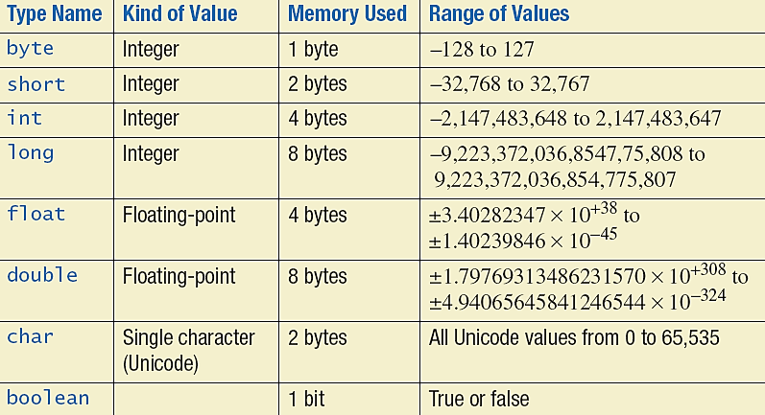
Primitive Data Types

Slide 17
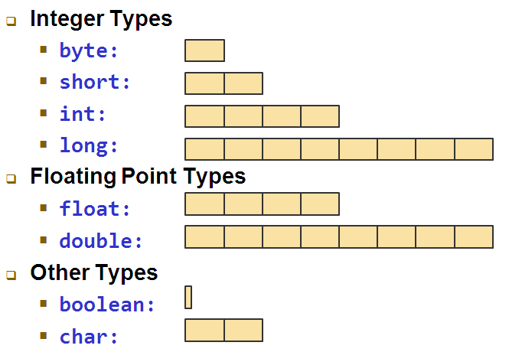
Storage per Type (in bytes)

Slide 18
Numeric Primitive Data
The difference between the numeric primitive types is their size and the values they can store:
Type
byte
short
int
long
float
double
Storage
8 bits
16 bits
32 bits
64 bits
32 bits
64 bits
Min Value
-128
-32,768
-2,147,483,648
< -9 x 10¹⁸
+/- 3.4 x 10³⁸ with 7 significant digits
+/- 1.7 x 10³⁰⁸ with 15 significant digits
Max Value
127
32,767
2,147,483,647
> 9 x 10¹⁸

Slide 19
Characters
A char variable stores a single character.
Character literals are delimited by single quotes:
'a' 'X' '7' '$' ',' '\n'
Example of declarations:
char topGrade = 'A';
char terminator = ';‘;
separator = ' ';
Note the difference between a primitive character variable, which holds only one character, and a String object, which can hold multiple characters
String name = "Mariam";

Slide 20
Character Sets
A character set is an ordered list of characters, with each character corresponding to a unique number.
A char variable in Java can store any character from the Unicode character set.
The Unicode character set uses sixteen bits per character, allowing for 65,536 unique characters.
It is an International character set, containing symbols and characters from many world languages.

Slide 21
Characters
The ASCII character set is older and smaller than Unicode, but is still quite popular.
The ASCII characters are a subset of the Unicode character set, including:
uppercase letters
lowercase letters
punctuation
digits
special symbols
control characters
A, B, C, …
a, b, c, …
period, semi-colon, …
0, 1, 2, …
&, |, \, …
escape, tab, ...

Slide 22
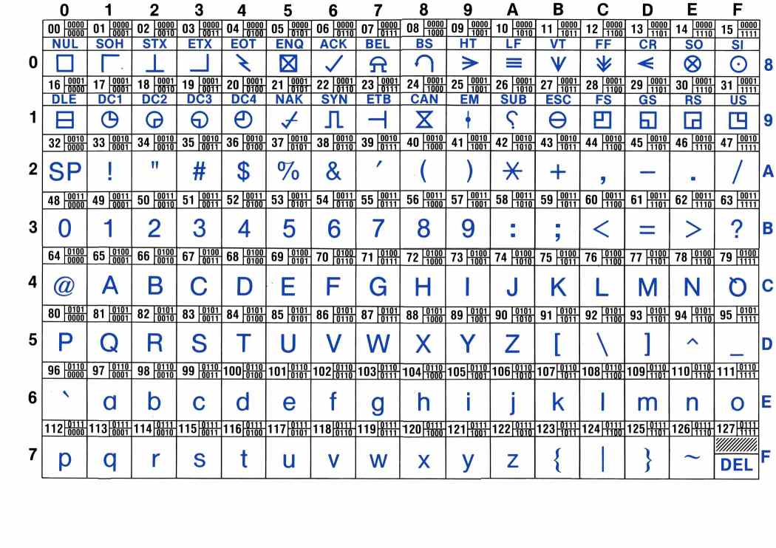
ASCII Character Set

Slide 23
Boolean
A boolean value represents a true or false condition
The reserved words true and false are the only valid values for a boolean type
boolean done = false;

Slide 24
e Notation
e notation is also called scientific notation or floating-point notation.
Examples
865000000.0 can be written as 8.65e8
0.000483 can be written as 4.83e-4

Slide 25
Assignment Statements
An assignment statement is used to assign a value to a variable.
answer = 42;
Equal sign (=) assignment operator
We say, "The variable named answer is assigned a value of 42," or more simply, "answer is assigned 42."
answer
42

Slide 26
Assignment Statements
Syntax
<variable> = <expression>
where expression can be another variable, or constant (such as a number), or something more complicated which combines variables using operators (such as + and -)
Examples
amount = 3.99;
firstInitial = 'W';
totalScore = carryMarks + finalExamMarks;
totalQuantity = quantity * 2;

Slide 27

Think
Are these declarations & assignments valid?:
String greeting = 20;
int age = "nineteen";
char name = " Rahmat ";
It is an ERROR to store a value whose type does not match the type of the variable!

Slide 28
Overflow
Happens when storage for a variable cannot hold the result.
Example:
int oneThousand = 1000; // no problem
int oneMillion = 1000 * oneThousand; // OK
int oneBillion = 1000 * oneMillion; // OK
int threeBillion = 3 * oneBillion;
System.out.println(threeBillion); // ??
Will print out -1294976296 Why?
The result (3 billion) overflowed int capacity
Maximum value for an int is 2,147,483,647
So how???
Use a long (or a double) instead of an int : 3000 000 000

Slide 29


Assignment Compatibilities
A value of one type can be assigned to a variable of any type further to the right, but not to a variable of any type further to the left.
If at least one of the operands is a floating-point type and the rest are integers, the result will be a floating point type.
byte-->short -->int-->long-->float-->double
Can be assigned to
Cannot be assigned to

Slide 30
Assignment Compatibilities
Java is said to be strongly typed.
You can't assign a double value to a variable declared to store integer. Example:
int intVariable = 7.0;
is not possible because intVariable is of type int
double doubleVariable = 7;
is possible even if doubleVariable is of type double.

Slide 31
Assignment Evaluation
The expression on the right-hand side of the assignment operator (=) is evaluated first.
The result is used to set the value of the variable on the left-hand side of the assignment operator.
totalMarks = carryMarks + finalExamMarks;
rectArea = length * width;

Slide 32
Initializing Variables
A variable that has been declared, but no yet given a value is said to be uninitialized.
Uninitialized primitive variables may have a default value.
It's good practice not to rely on a default value.
Usually Java compilers will give error or warning if you attempt to use an uninitialized variable.

Slide 33
Uninitialized Variables
Error:
int luckyNumber; System.out.println(luckyNumber); // ERROR - uninitialized variable
luckyNumber
An Uninitialized Variable: undefined value

Slide 34
Initializing Variables
To protect against an uninitialized variable (and to keep the compiler happy), assign a value when the variable is declared.

Slide 35
Initializing Variables
Syntax:
<data type> <variable name1> = <expression1>;
<data type> <variable name2> = <expression2>; …;
Examples:
int count = 0;
char grade = 'A';
double price = 0.00;

Slide 36
Simple Screen Output
int count = 250;
System.out.println("The count is " + count);
Outputs the string literal "The count is " Followed by the current value of the variable count.
Output:
The count is 250

Slide 37
Geometry.java
public class Geometry
{
public static void main (String[] args)
{
int sides = 7; // declaration with initialization
System.out.println ("A heptagon has " + sides + " sides.");
sides = 10; // assignment statement
System.out.println ("A decagon has " + sides + " sides.");
sides = 12;
System.out.println ("A dodecagon has " + sides + " sides.");
}
}
sides
sides
sides
7
10
12

Slide 38
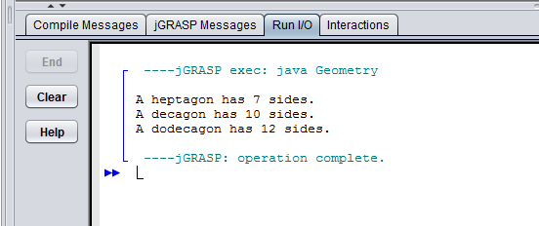
Output

Slide 39
Geometry.java
public class Geometry
{
public static void main (String[] args)
{
int sides1, sides2, sides3; // declaration
sides1 = 7; // assignment statement
System.out.println ("A heptagon has " + sides1 + " sides.");
sides2 = 10; // assignment statement
System.out.println ("A decagon has " + sides2 + " sides.");
sides3 = 12; // assignment statement
System.out.println ("A dodecagon has " + sides3 + " sides.");
}
}
sides1
sides2
sides3
7
10
12

Slide 40

SIMPLE TEST
Create a class named FirstCalculator
Declare a variable number1 of type double and initialize it as 20.00.
Declare a variable number2 of type double and initialize it as 30.00.
Declare a constant ADDITIONAL of type integer and initialize it as 4.
Declare a variable totalCalculation of type double.
Calculate the total calculation by using this formula:
totalCalculation = number1+number2 *ADDITIONAL
Print out the total calculation.

Slide 41
Outline
Variables
Primitive Data Types & Assignments
Character Strings
Expressions
Expressions & order of precedence

Slide 42
Character Strings
A string literal is represented by putting double quotes around the text
Examples:
"This is a string literal."
"123 Main Street"
"X"
Every character string is an object in Java, defined by the String class
Every string literal represents a String object

Slide 43
The println Method
In the previous examples, we invoked the println method to print a character string
The System.out object represents a destination (the monitor screen) to which we can send output
System.out.println ("Whatever you are, be a good one.");
object
method
name
information provided here will be
printed as it is

Slide 44
The printf Method
Used to format the output.
Syntax:
System.out.printf(formatString , items);
where
- formatString: a string with format specifiers
- items: list of data/variables to be displayed
printf method only supported in JDK 5 and higher version.

Slide 45
Formatting Output: Format Specifiers
-Format specifier specifies how item should be displayed.
-Frequently used format type specifiers.
Specifiers | Outputs | Examples
%d | decimal integer | 200
%f | a float number | 35.3404
%s | a string | “Java”
%c | a character | ‘T’
%b | a boolean value | true
%n | line separator
%e | exponential | 1.23e+1

Slide 46
Formatting Output
Syntax of format specifier:
%<flag><width><.precision><format type>
%wd – output integer with width of w (eg. %5d)
– if the number is less than 5 (w), add spaces
before the number.
– if the number is more than 5 (w), the width
is added automatically.
%w.pf – output double value with width of w including
decimal point and p digits after the decimal point
(eg. %10.2f)

Slide 47
Formatting Output: Flag
Flag Description_________
- Left justifies the converted value
by default the value is right justified)
, Include comma separator for >= 1000 value
( Enclose ( ) for negative value

Slide 48
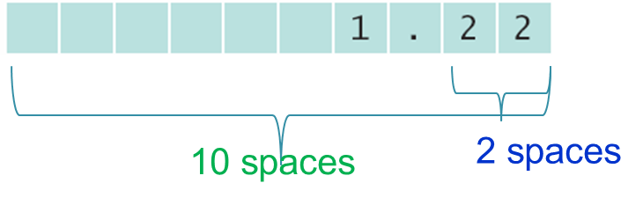
Formatting Output
Default: 6 digits after the decimal point
Outputting floating point values can look strange:
Price per liter: RM 1.219978
To control the output appearance of numeric variables, use formatted output tools such as:
double price = 1.219978;
a) System.out.printf(" Price per liter:RM %.3f", price);
Price per liter:RM1.220
b) System.out.printf(" Price per liter:RM %10.2f", price);
Price per liter:RM 1.22
The %10.2f is called a format specifier

Slide 49
Example
int x= 10;
double y= 5.373123;
System.out.printf("X is %d and Y is %6.2f", x, y);
OUTPUT:
X is 10 and Y is
Note:
items MUST match specifiers in order, in number and in exact type
5
.
3
7
6 spaces

Slide 50
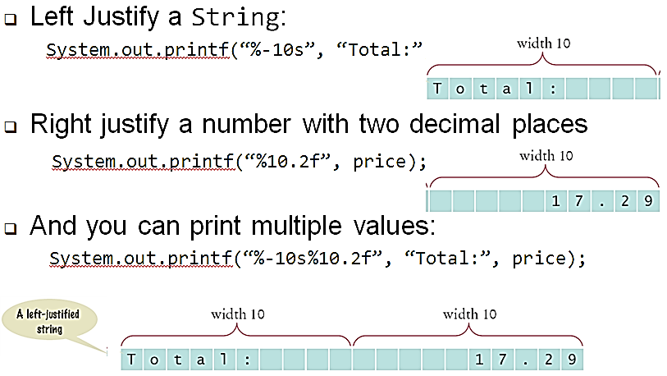
Formatting examples
);

Slide 51
Formatting Exercises
What is the output from each of the following printf statements?
System.out.printf("%3d", 5);
System.out.printf("%3d", 12345);
System.out.printf("%5.2f", 7.24);
System.out.printf("%5.2f", 7.277);
System.out.printf("%5.2f", 123.456);
System.out.printf("%5.2f", 123.4);
System.out.printf("%-5.2f", 7.277);
System.out.printf("%-5.2f", 123.456);
System.out.printf (“%-8d%8s%8.2f”, 1234, “Java”, 4.7);
What are the errors in each of the following printf statements?
System.out.printf("%f", 5);
System.out.printf("%4d", 123.4);
System.out.printf("value 1: %d value 2: d", 5, 10);

Slide 52
SIMPLE TEST (Cont.)
Use your FirstCalculator class and format the output of total calculation by using printf
Total: RM140.00

Slide 53
String Concatenation
The string concatenation operator (+) is used to append one string to the end of another.
"Peanut butter " + "and jelly"
It can also be used to append a number to a string.
"My matric number " + 1199
A string literal cannot be broken across two lines in a program.
"My name is "My name is"
Tina" + "Tina"

Slide 54
//********************************************************************
// Facts.java Author: Lewis/Loftus
//
// Demonstrates the use of the string concatenation operator and the
// automatic conversion of an integer to a string.
//********************************************************************
public class Facts
{
//-----------------------------------------------------------------
// Prints various facts.
//-----------------------------------------------------------------
public static void main (String[] args)
{
// Strings can be concatenated into one long string
System.out.println ("We present the following facts for your "
+ "extracurricular edification:");
System.out.println ();
// A string can contain numeric digits
System.out.println ("Letters in the Hawaiian alphabet: 12");
continue

Slide 55
continue
// A numeric value can be concatenated to a string
System.out.println ("Dialing code for Antarctica: " + 672);
System.out.println ("Year in which Leonardo da Vinci invented "
+ "the parachute: " + 1515);
System.out.println ("Speed of car: " + 120 + " km per hour");
}
}
Output
We present the following facts for your extracurricular edification:
Letters in the Hawaiian alphabet: 12
Dialing code for Antarctica: 672
Year in which Leonardo da Vinci invented the parachute: 1515
Speed of car: 120 km per hour

Slide 56
String Concatenation
The + operator is also used for arithmetic addition.
The function that it performs depends on the type of the information on which it operates.
If both operands are strings, or if one is a string and one is a number, it performs string concatenation.
If both operands are numeric, it adds them.
The + operator is evaluated left to right, but parentheses can be used to force the order.

Slide 57
//********************************************************************
// Addition.java Author: Lewis/Loftus
//
// Demonstrates the difference between the addition and string
// concatenation operators.
//********************************************************************
public class Addition
{
//-----------------------------------------------------------------
// Concatenates and adds two numbers and prints the results.
//-----------------------------------------------------------------
public static void main (String[] args)
{
System.out.println ("24 and 45 concatenated: " + 24 + 45);
System.out.println ("24 and 45 added: " + (24 + 45));
}
}
Output
24 and 45 concatenated: 2445
24 and 45 added: 69

Slide 58
Quick Check
What are the outputs produced by the following statements?
System.out.println ("X: " + 25);
System.out.println ("Y: " + (15 + 50));
System.out.println ("Z: " + 300 + 50);
X: 25
Y: 65
Z: 30050

Slide 59
PianoKeys.java
public class PianoKeys
{
//-----------------------------------------------------------------
// Prints the number of keys on a piano.
//-----------------------------------------------------------------
public static void main (String[] args)
{
int keys = 88;
System.out.println ("A piano has " + keys + " keys.");
}
}

Slide 60
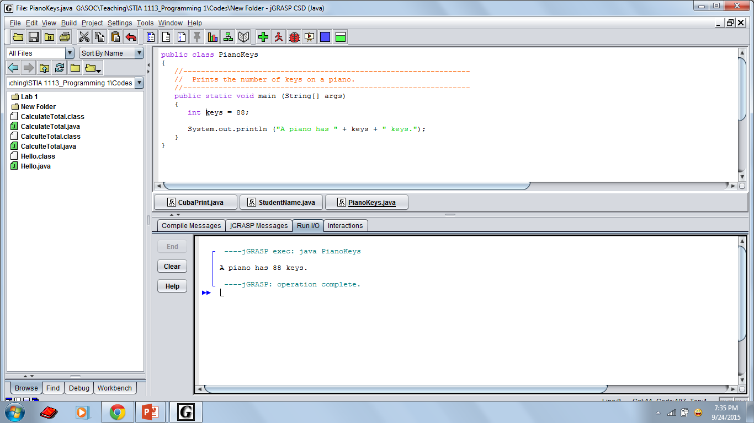
Output

Slide 61
Exercise
What is the output of this code?
public class PrintInfo { public static void main(String[] args) { String name = "Muhammad"; double salary = 5000.00; int yearsOfExperience = 6; System.out.println("The name of employee is " +name); System.out.println(name + "'s salary is " +salary); System.out.println("He has " +yearsOfExperience
+" years of experience"); } }

Slide 62
Escape Sequences
How if we want to print a quoted character?
I said “Hello” to you
The following line would confuse the compiler because it would interpret the second quote as the end of the string
System.out.println ("I said "Hello" to you.");
An escape sequence is a series of characters that represents a special character
An escape sequence begins with a backslash character (\)
System.out.println ("I said \"Hello\" to you.");

Slide 63
Escape Sequences
Some Java escape sequences:
Escape Sequence
\b
\t
\n
\r
\"
\'
\\
Meaning
backspace
tab
newline
carriage return (returns cursor to the
beginning of current line)
double quote
single quote
backslash

Slide 64
//********************************************************************
// Roses.java Author: Lewis/Loftus
//
// Demonstrates the use of escape sequences.
//********************************************************************
public class Roses
{
//-----------------------------------------------------------------
// Prints a poem (of sorts) on multiple lines.
//-----------------------------------------------------------------
public static void main (String[] args)
{
System.out.println ("Roses are red,\n\t Violets are blue,\n" +
"Sugar is sweet,\n\t But I have \"commitment issues\",\n\t" +
"So I'd rather just be friends\n\t At this point in our " +
"relationship.");
}
}
Output
Roses are red,
Violets are blue,
Sugar is sweet,
But I have "commitment issues",
So I'd rather just be friends
At this point in our relationship.

Slide 65

Quick Check
Write a single println statement that produces the following output:
"Thank you all for coming to my home tonight," he said mysteriously.
System.out.println ("\"Thank you all for " +
"coming to my home\n tonight,\" he said " +
"mysteriously.");

Slide 66
Outline
Variables
Primitive Data Types & Assignments
Character Strings
Expressions & order of precedence

Slide 67
Expressions
A combination of one or more operators and operands that usually perform a calculation.
The simplest expression is a literal value.
A more complex expression can have operators and/or parentheses.
The values that an operator applies to are called operands.
5 common arithmetic operators
+ Addition
- Subtraction or negation
* Multiplication
/ Division
% Modulus, a.k.a. remainder

Slide 68
Expressions
A combination of one or more operators and operands that usually perform a calculation.
The simplest expression is a literal value.
A more complex expression can have operators and/or parentheses.
The values that an operator applies to are called operands.
5 common arithmetic operators
+ Addition
- Subtraction or negation
* Multiplication
/ Division
% Modulus, a.k.a. remainder

Slide 69
Examples of Expressions
Operators
1 + 4 * 3
Operator
10 + 5
Operands
Operands

Slide 70
Evaluating expressions
When your Java program executes and encounters a line with an expression, the expression is evaluated (its value is computed).
The expression 3 * 4 is evaluated to obtain 12.
System.out.println(3 * 4) prints 12, not 3 * 4.
(How could we print the text 3 * 4 on the screen?)

Slide 71
Quick Check
What are the outputs?
System.out.println(3 + 4);
System.out.println("Value is" +3+4);
System.out.println(3+4+ " is seven ");
System.out.println("Value is " +(3+4));
System.out.println(3/4);
7
Value is 34
7 is seven
Value is 7
0

Slide 72
Integer division with /
Strangely, 14 / 4 evaluates to 3, not 3.5.
In Java, when we divide integers, the result is also an integer: the integer quotient.
The integer quotient of dividing 14 by 4 is 3. Imagine that you are doing long division:
3 52
4 14 27 1425
12 135
2 75
54
21
Examples: 35 / 5 is 7, 84 / 10 is 8, 156 / 100 is 1
Dividing by 0 causes a runtime error in your program.
Notes:
Dividing by 0 crashes the program.

Slide 73
Integer remainder with %
The modulus (%) operator computes the remainder from a division of integers.
Example: 14 % 4 is 2
Example: 218 % 5 is 3
3 43
4 14 5 218
12 20
2 18
15
3
What are the results of the following expressions?
45 % 6
2 % 2
20 % 8
11 % 5
Notes:
What is 8 % 20? It's 8, but they will probably say 0.

Slide 74
Application of % operator
Can the % operator help us determine whether a number is even or odd? Can it help us determine whether a number is divisible by, say, 27?
7 13
2 14 2 27
14 2
0 06
1
14 is an even number
27 is an odd number
Notes:
Answers:
230857 % 10
658236489 % 10000
7342 % 100 / 10 or (7342 / 10) % 10
If the number % 2 is 0, it is even, otherwise it is odd.

Slide 75
Evaluating expressions
When an expression contains more than one operator of the same kind, it is evaluated left-to-right.
Example: 1 + 2 + 3 is (1 + 2) + 3 which is 6
Example: 1 - 2 - 3 is (1 - 2) - 3 which is -4
(Not the same as 1 - (2 - 3) which is 2)

Slide 76
Operator precedence
How does Java evaluate 1 + 3 * 4?
Is it (1 + 3) * 4, or is it 1 + (3 * 4)?
Precedence: Order in which operations are computed in an expression. Multiplicative operators have a higher level of precedence than additive operators.
* / % are evaluated before + -
In our example, * has higher precedence than +, just like on a scientific calculator, so 1 + 3 * 4 is 13.
Parentheses can be used to force a certain order of evaluation.
(1 + 3) * 4 is 16.
Spacing does not affect order of evaluation.
1+3 * 4-2 is 11.

Slide 77
Precedence Rules
A unary operator has one operand
A binary operator has two operands
The BINARY ARITHMETIC OPERATORS
*, /, and %, have LOWER precedence than the UNARY OPERATORS +, -, ++, --, and !, but have HIGHER PRECEDENCE than the BINARY ARITHMETIC OPERATORS + and -.

Slide 78
Precedence Rules
When BINARY ARITHMETIC OPERATORS have EQUAL precedence, the operator on the LEFT acts before the operator(s) on the RIGHT.
When UNARY operators have EQUAL precedence, the operator on the RIGHT acts before the operation(s) on the LEFT.
Even when parentheses are not needed, they can be used to make the code clearer.
balance + (interestRate * balance)

Slide 79
Precedence Rules
Precedence | Operators
First | ( )
Second | +, -, !, ++, --
Third | *, /, %
Fourth | +, -
Highest
Lowest

Slide 80
Operator Precedence
What is the order of evaluation in the following expressions?
a + b + c + d + e
a + b * c - d / e
1
2
3
4
3
1
4
2
a / (b + c) - d % e
2
1
4
3
a / (b * (c + (d - e)))
4
3
2
1

Slide 81
Precedence examples
1 * 2 + 3 * 5 / 4
\_/ | 2 + 3 * 5 / 4
\_/ | 2 + 15 / 4
\___/ | 2 + 3
\________/ | 5
1 + 2 / 3 * 5 - 4
\_/ | 1 + 0 * 5 - 4
\___/ | 1 + 0 - 4
\______/ | 1 - 4
\___/ | -3

Slide 82
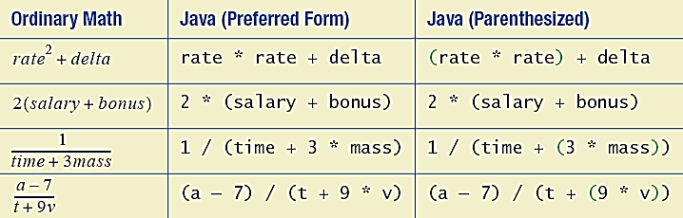
Sample Expressions

Slide 83
Quick Check
What values result from the following expressions?
9 / 5
695 % 20
7 + 6 * 5
7 * 6 + 5
248 % 100 / 5
6 * 3 - 9 / 4
(5 - 7) * 4
6 + (18 % (17 - 12))
10 / 3 * 4 % 8 + 2 * (4 / 2)
(30/5) * 3 + 23 % 5 + 10

Slide 84
Assignment Revisited
The assignment operator has a lower precedence than the arithmetic operators
First the expression on the right hand
side of the = operator is evaluated
answer = sum / 4 + MAX * lowest;
4
1
3
2
Then the result is stored in the variable on the left hand side

Slide 85
Real numbers (double)
The expressions we have seen so far used integers (type int), but Java also can manipulate real numbers with a decimal point (type double).
Examples: 6.022 -15.9997 42.0 2.143e17
The operators we saw, + - * / % ( ) , all work for real numbers as well.
The / produces an exact answer when used on real numbers.
Example: 15.0 / 2.0 is 7.5
The same rules of precedence that apply to integers also apply to real numbers.
( ) before * / % before + -
Notes:
Point out that it's odd for 42.0 to be considered a real number, but it is. Also point out that the 2.143e17 is scientific notation and means (2.143 * 10^17).

Slide 86
Real number example
2.0 * 2.4 + 2.25 * 4.0 / 2.0
\___/ | 4.8 + 2.25 * 4.0 / 2.0
\___/ | 4.8 + 9.0 / 2.0
\_____/ | 4.8 + 4.5
\____________/ | 9.3

Slide 87
Real number precision
Consider the following statement:
System.out.println((35.0 + 22.4 + 11.9) / 3.0);
The mathematically correct answer should be 23.1
Instead, the output is 23.099999999999998
The computer internally represents real numbers in an imprecise way, so some calculations with them are slightly incorrect.
Later we will learn some ways to produce a better output for examples like above.

Slide 88
Mixing integers and real numbers
When a Java operator is used on an integer and a real number, the result is a real number.
Example: 3 * 4.2 is 12.6
Example: 1 + 1.0 is 2.0
The kind of number that results from a given operator depends only on its operands, not any other operands.

Slide 89
Mixed types example
2.0 + 10 / 3 * 2.5 - 6 / 4
\___/ | 2.0 + 3 * 2.5 - 6 / 4
\_____/ | 2.0 + 7.5 - 6 / 4
\_/ | 2.0 + 7.5 - 1
\_________/ | 9.5 - 1
\______________/ | 8.5

Slide 90
Specialized Assignment Operators
Assignment operator can be combined with arithmetic operators (including -, *, /, and %).
amount = amount + 5;
can be written as
amount += 5;
yielding the same results.

Slide 91
Assignment Operators
Operators
+=
-=
*=
/=
%=
Examples
x += y
x -= y
x *= y
x /= y
x %= y
Equivalent to
x = x + y
x = x - y
x = x * y
x = x / y
x = x % y

Slide 92
Assignment Operators
The right hand side of an assignment operator can be a complex expression.
The entire right-hand expression is evaluated first, then the result is combined with the original variable.
Therefore
result /= (total_MIN) % num;
is equivalent to
result = result / ((total_MIN) % num);

Slide 93
Examples
int count = 5; count += 10; System.out.println("Count value becomes: " +count);
double totalPrice = 15.0; int quantity = 3; totalPrice *= quantity; System.out.println("Total price is: " +totalPrice);

Slide 94
Exercise
What are the values of result and number at
then end of the following codes?
int result = 27; result +=3; result /=7; result *= 2;
int number = 10; number +=10; number *=number; number /= number; number -=10;
Notes:
Answers:
1
15
37
47
9
16
-8
9
The outermost parentheses in the last expression are unnecessary.

Slide 95
Exercise
public class StringCont
{
//-----------------------------------------------------------------
// Concatenates string and prints out the result
//-----------------------------------------------------------------
public static void main (String[] args)
{
String s1;
String s2 = "and I said Hello";
s1 = "goodbye!";
s1 = "You said " +s1;
s1 += ", " + s2 + ".";
System.out.println (s1);
}
}

Slide 96
Increment and Decrement Operators
Used to increase (or decrease) the value of a variable by 1.
Easy to use, important to recognize.
The increment operator
count++ or ++count
The decrement operator
count-- or --count

Slide 97
Increment Operator
count++;
++count;
First, one is added to the
original value of count
count = count + 1;
Then the result is stored back into count
(overwriting the original value)

Slide 98
Decrement Operator
count--;
--count;
First, one is subtracted from the
original value of count
count = count - 1;
Then the result is stored back into count
(overwriting the original value)

Slide 99
Pre/Post Increment/Decrement Operator
++count;
--count;
Pre Increment/Decrement:
Value is incremented/decremented first,
then the incremented value is used in the expression
Post Increment/Decrement:
Value is used in the expression first, then
the value is incremented/decremented
count++;
count--;

Slide 100
Increment and Decrement Operators in Expressions
after executing
int m = 4;
int result = 3 * (++m)
result has a value of 15 and m has a value of 5
after executing
int m = 4;
int result = 3 * (m++)
result has a value of 12 and m has a value of 5

Slide 101
Exercise
Q1
What are the outputs?
int carry Marks = 40;
int total Marks = 55 + carryMarks++;
System.out.println("The total marks is " +totalMarks);
System.out.println("The current value of carryMarks is “ + carryMarks);
Q2
int count = 5; double amount = 10.00; count += 10;
System.out.println("Count value becomes: " +count--); System.out.println("The amount value is: RM " +(amount *3));
Notes:
Answers:
1
15
37
47
9
16
-8
9
The outermost parentheses in the last expression are unnecessary.

Slide 102
Exercise
Q2
What are the outputs?
int a = 1;
int b = 2;
int c;
int d;
c = ++b;
d = a++;
++c;
System.out.println("a = " + a);
System.out.println("b = " + b);
System.out.println("c = " + c);
System.out.println("d = " + d);
Q1
int no1 = 1;
int no2 = 1;
int num1 = 10 - no1++;
int num2 = 10 + (++no2);
System.out.println("num1 = " + num1);
System.out.println("num2 = " + num2);
Notes:
Answers:
1
15
37
47
9
16
-8
9
The outermost parentheses in the last expression are unnecessary.

Slide 103

TODAY’S TAKE AWAY
The declaration and use of variables
Primitive data
Character strings
Expressions and order of precedence

